Slide 1
ILS Characterization
ExoMars TGO NOMAD
Solar Occultation (SO) channel
Giuliano Liuzzi
Geronimo Villanueva
NASA/GSFC – March-May/2021

Slide 2
Method to derive the ILS: self-correlation

Slide 3
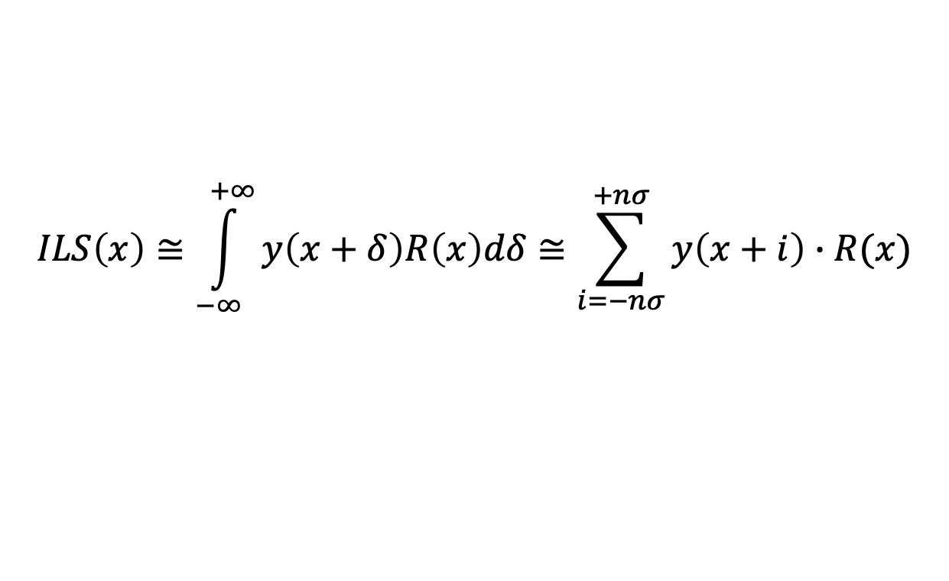
Method to derive the ILS: self-correlation
This technique uses the intrinsic information content of the spectrum y(x) in a completely agnostic way, i.e. not assuming any a-priori lineshape functional form, nor any hypothesis about how well isolated lines are.
The method relies only on a good high-resolution model R(x) for the signal, which must include a reliable model for the AOTF in order to include all visible lines.
$$ILS\left(x\right)≅\int_{−∞}^{+∞}{y\left(x+δ\right)R\left(x\right)dδ≅\sum_{i=−nσ}^{+nσ}{y\left(x+i\right)∙R(x)}}$$
If the ILS varies locally within the spectrum, the ILS can be calculated on narrow spectral interval. However, this will introduce more noise, so in deriving the ILS a trade-off needs to be established.

Slide 4
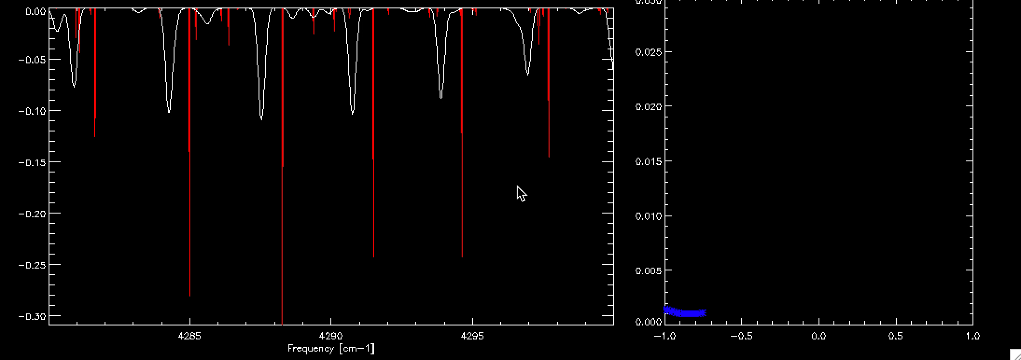
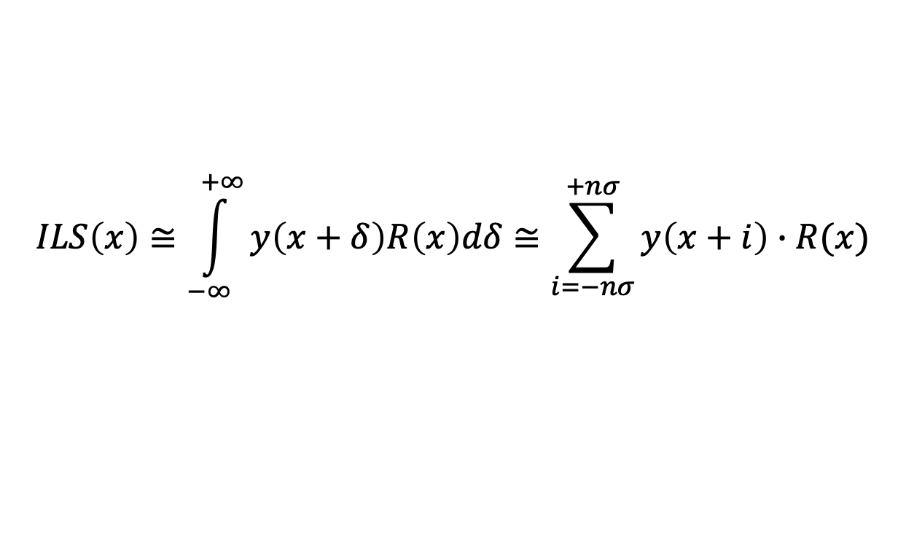
$$ILS\left(x\right)≅\int_{−∞}^{+∞}{y\left(x+δ\right)R\left(x\right)dδ≅\sum_{i=−nσ}^{+nσ}{y\left(x+i\right)∙R(x)}}$$

Slide 5
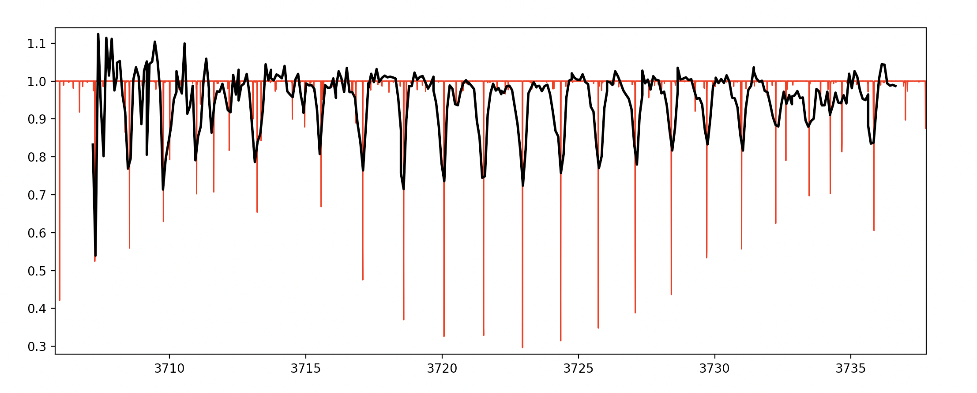

Order 165: observation (10x) vs. model (RP 200,000)
H = 130 km, bin 3
j changes
$$Σ$$
Shift = +/- 1.2 cm⁻¹
30% of the spectrum

Slide 6
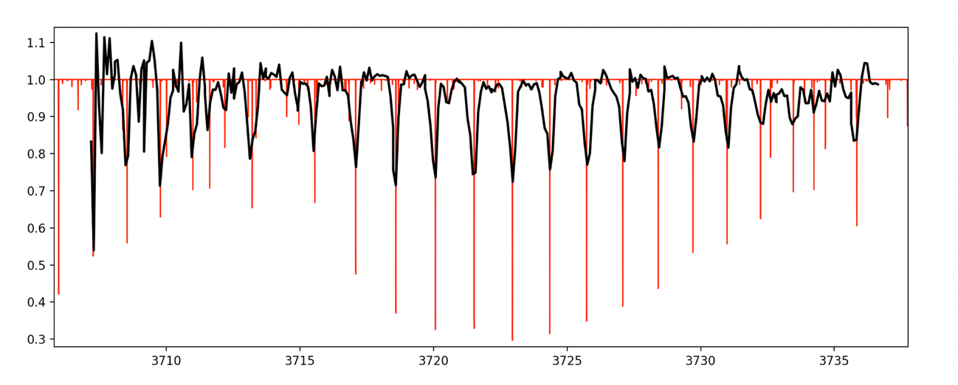
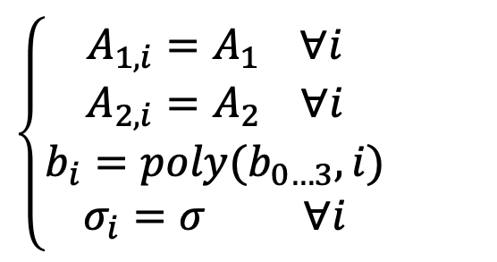
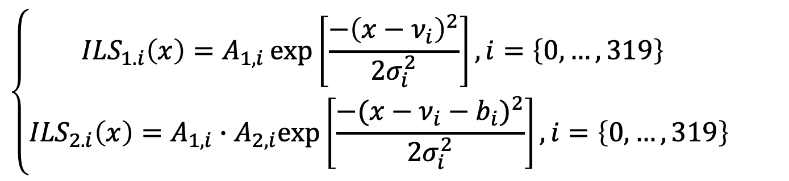
Order 165: functional form for the ILS
$$\left\{\begin{aligned}A_{1,i}=A_{1} ∀i \\ A_{2,i}=A_{2} ∀i \\ b_{i}=poly(b_{0…3},i) \\ σ_{i}=σ ∀i\end{aligned}\right.$$
H = 130 km, bin 3
$$\left\{\begin{aligned}{ILS}_{1.i}\left(x\right)=A_{1,i}\exp\left[\frac{−{\left(x−ν_{i}\right)}^{2}}{2σ_{i}^{2}}\right], i=\left\{0,…,319\right\} \\ {ILS}_{2.i}\left(x\right)=A_{1,i}∙A_{2,i}exp⁡\left[\frac{−{(x−ν_{i}−b_{i})}^{2}}{2σ_{i}^{2}}\right], i=\left\{0,…,319\right\}\end{aligned}\right.$$

Slide 7
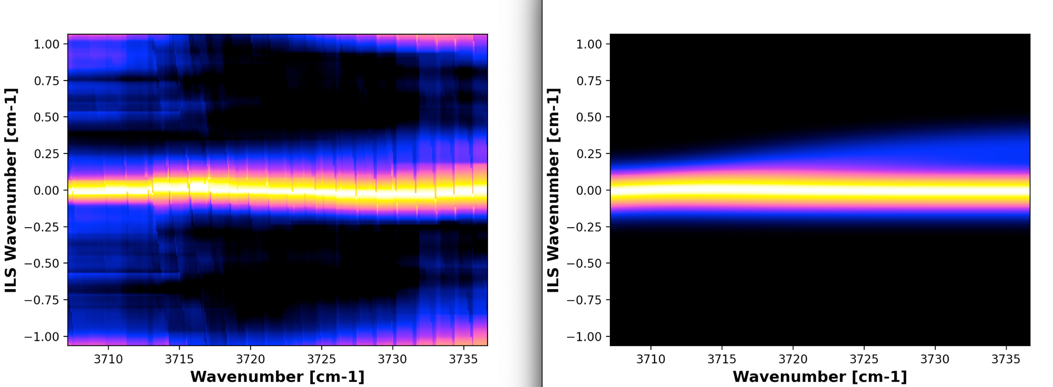
Order 165: functional form for the ILS
ILS computed from the spectrum
Modeled ILS

Slide 8
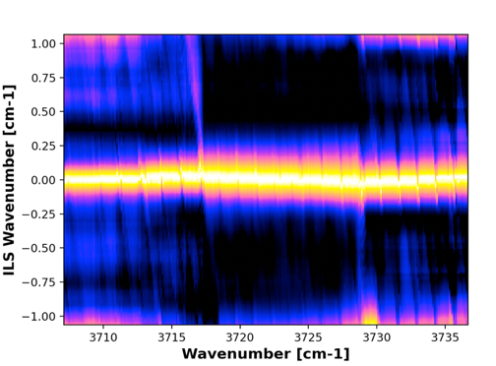
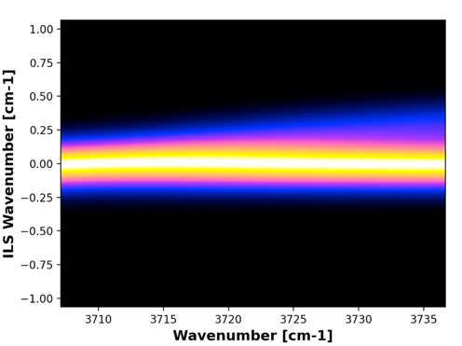
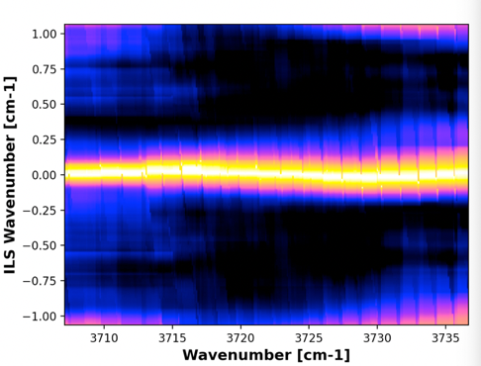
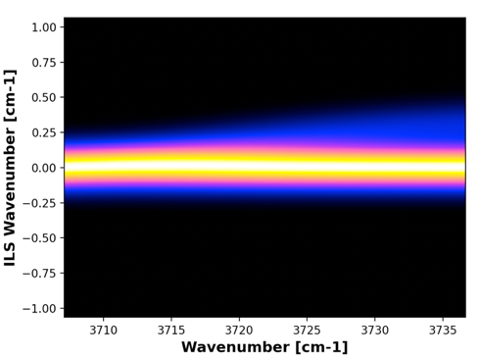
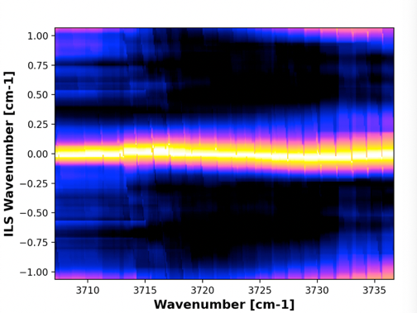
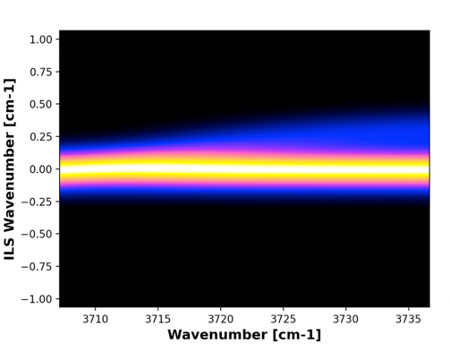
Order 165: are we immune from altitude (i.e. line saturation)?
H = 70 km, bin 3 (VERY saturated)
b_{0…3} = -1.35561e-10, -2.47316e-06, 1.50305e-03, 7.37273e-03
(shift 0.007 to 0.23 cm⁻¹)
σ = 1.05804e-01 cm⁻¹
A₂ = 2.85389e-01
H = 100 km, bin 3 (partially saturated)
b_{0…3} = -2.15478e-09, -3.44165e-07, 1.20833e-03, 9.42663e-03
(shift 0.009 to 0.289 cm⁻¹)
= 9.78230e-02 cm⁻¹
A₂ = 2.36054e-01
H = 130 km, bin 3 (not saturated)
b_{0…3} = 1.17410e-09, -2.81659e-06, 1.68969e-03, -2.27274e-03
(shift -0.002 to 0.288 cm⁻¹)
= 9.30255e-02 cm⁻¹
A₂ = 2.36054e-01

Slide 9
Current recipes: a comparison

Slide 10
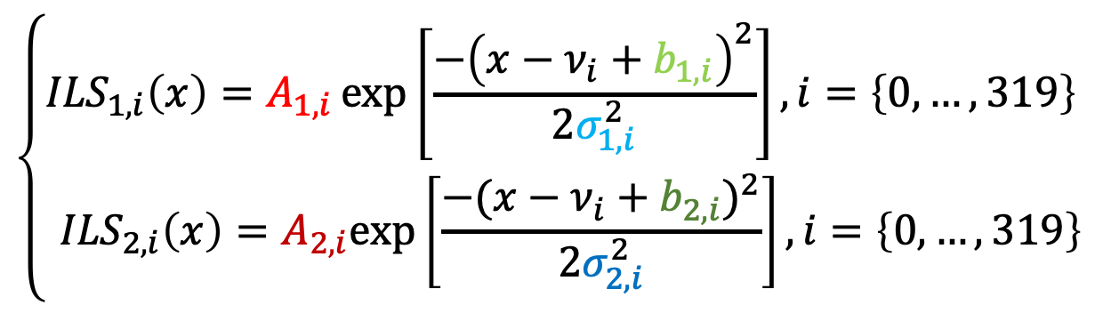
* Applied to both gaussians
$$\left\{\begin{aligned}{ILS}_{1,i}\left(x\right)=A_{1,i}\exp\left[\frac{−{\left(x−ν_{i}+b_{1,i}\right)}^{2}}{2σ_{1,i}^{2}}\right], i=\left\{0,…,319\right\} \\ {ILS}_{2,i}\left(x\right)=A_{2,i}exp⁡\left[\frac{−{(x−ν_{i}+b_{2,i})}^{2}}{2σ_{2,i}^{2}}\right], i=\left\{0,…,319\right\}\end{aligned}\right.$$
 | A₁ | A₂ | σ₁ | σ₂ | b₁ | b₂ | Tot. pars
BIRA | 2 | 2 | 2 | 2 | 2 | 2 | 12
IAA |  | 2 | 2 |  | 2* | 2 | 8
GSFC |  | 1 | 1 |  |  | 3 | 5

Slide 11


* Applied to both gaussians
$$\left\{\begin{aligned}{ILS}_{1,i}\left(x\right)=A_{1,i}\exp\left[\frac{−{\left(x−ν_{i}+b_{1,i}\right)}^{2}}{2σ_{1,i}^{2}}\right], i=\left\{0,…,319\right\} \\ {ILS}_{2,i}\left(x\right)=A_{2,i}exp⁡\left[\frac{−{(x−ν_{i}+b_{2,i})}^{2}}{2σ_{2,i}^{2}}\right], i=\left\{0,…,319\right\}\end{aligned}\right.$$
 | A₁ | A₂ | σ₁ | σ₂ | b₁ | b₂ | Tot. pars
BIRA | 2 | 2 | 2 | 2 | 2 | 2 | 12
IAA |  | 2 | 2 |  | 2* | 2 | 8
GSFC |  | 1 | 1 |  |  | 3 | 5
1
1
The width is defined by the grating grooves and its quality. There is only one grating, σ₁≡σ₂ ≈ σ

Slide 12
* Applied to both gaussians
$$\left\{\begin{aligned}{ILS}_{1,i}\left(x\right)=A_{1,i}\exp\left[\frac{−{\left(x−ν_{i}+b_{1,i}\right)}^{2}}{2σ_{1,i}^{2}}\right], i=\left\{0,…,319\right\} \\ {ILS}_{2,i}\left(x\right)=A_{2,i}exp⁡\left[\frac{−{(x−ν_{i}+b_{2,i})}^{2}}{2σ_{2,i}^{2}}\right], i=\left\{0,…,319\right\}\end{aligned}\right.$$
 | A₁ | A₂ | σ₁ | σ₂ | b₁ | b₂ | Tot. pars
BIRA | 2 | 2 | 2 | 2 | 2 | 2 | 12
IAA |  | 2 | 2 |  | 2* | 2 | 8
GSFC |  | 1 | 1 |  |  | 3 | 5
1
1
The width is defined by the grating grooves and its quality. There is only one grating, σ₁≡σ₂ ≈ σ
Shifts to the main kernel imply issues with the frequency calibration, not the ILS

Slide 13
* Applied to both gaussians
$$\left\{\begin{aligned}{ILS}_{1,i}\left(x\right)=A_{1,i}\exp\left[\frac{−{\left(x−ν_{i}+b_{1,i}\right)}^{2}}{2σ_{1,i}^{2}}\right], i=\left\{0,…,319\right\} \\ {ILS}_{2,i}\left(x\right)=A_{2,i}exp⁡\left[\frac{−{(x−ν_{i}+b_{2,i})}^{2}}{2σ_{2,i}^{2}}\right], i=\left\{0,…,319\right\}\end{aligned}\right.$$
 | A₁ | A₂ | σ₁ | σ₂ | b₁ | b₂ | Tot. pars
BIRA | 2 | 2 | 2 | 2 | 2 | 2 | 12
IAA |  | 2 | 2 |  | 2* | 2 | 8
GSFC |  | 1 | 1 |  |  | 3 | 5
1
1
1
1
In half of the detector, the two gaussians overlap, therefore it is hard to accurately derive A₁/A₂
The width is defined by the grating grooves and its quality. There is only one grating, σ₁≡σ₂ ≈ σ
Shifts to the main kernel imply issues with the frequency calibration, not the ILS

Slide 14
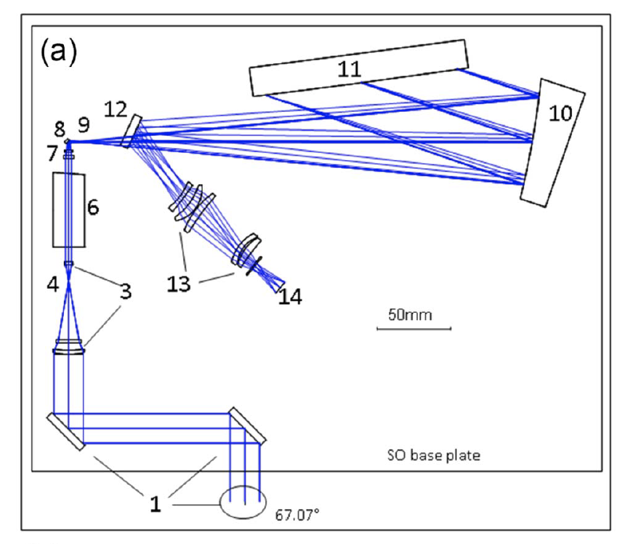
Aperture
GRATING
2
Slit
Parabolic mirror
AOTF
1
Detector

Slide 15
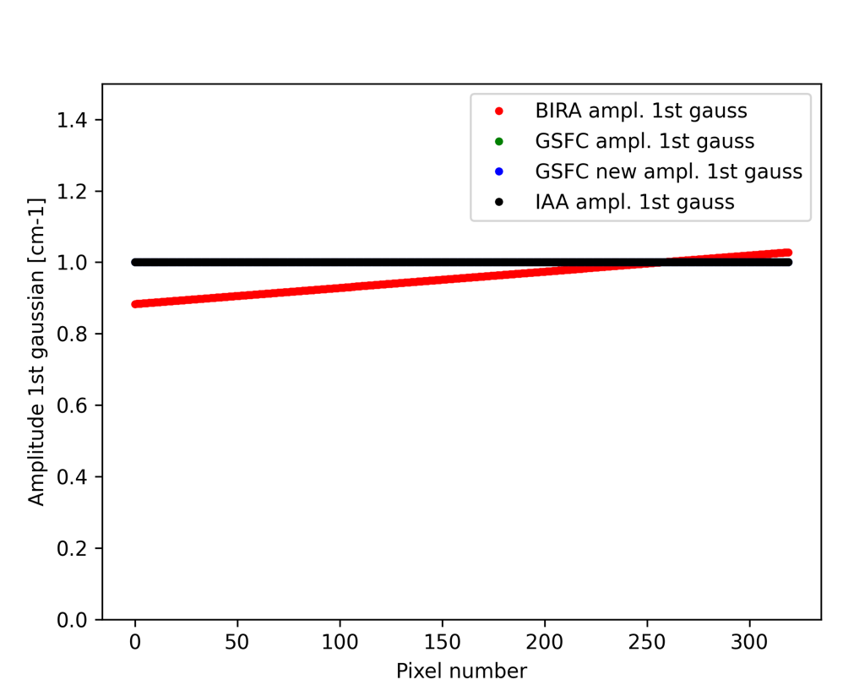
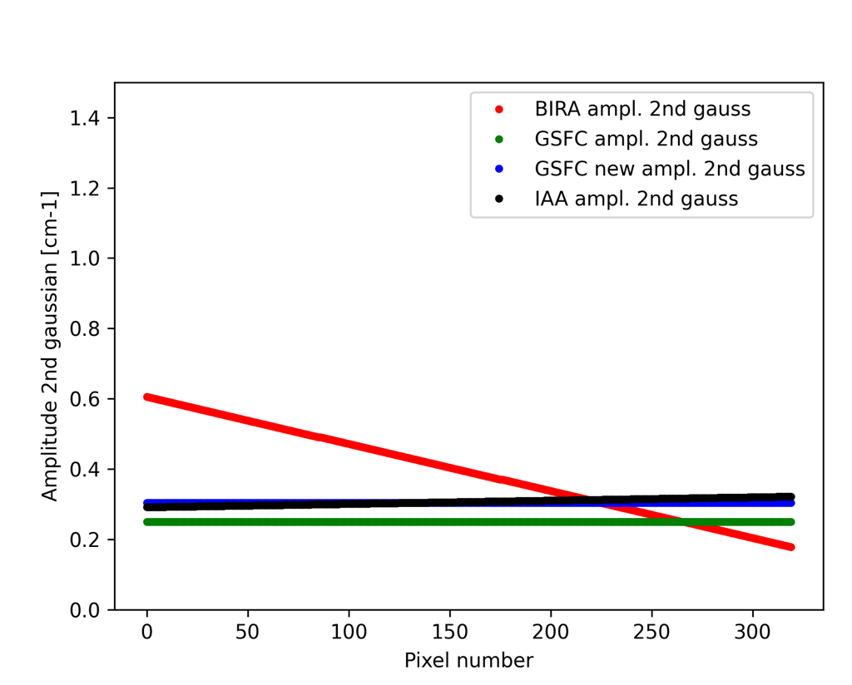
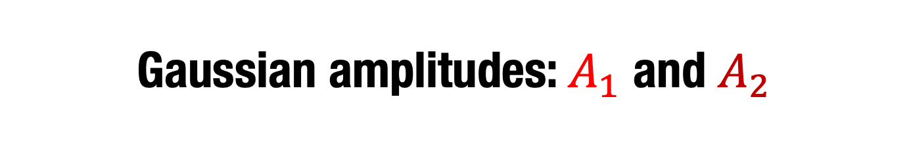
Gaussian amplitudes: $A_{1}$ and $A_{2}$

Slide 16
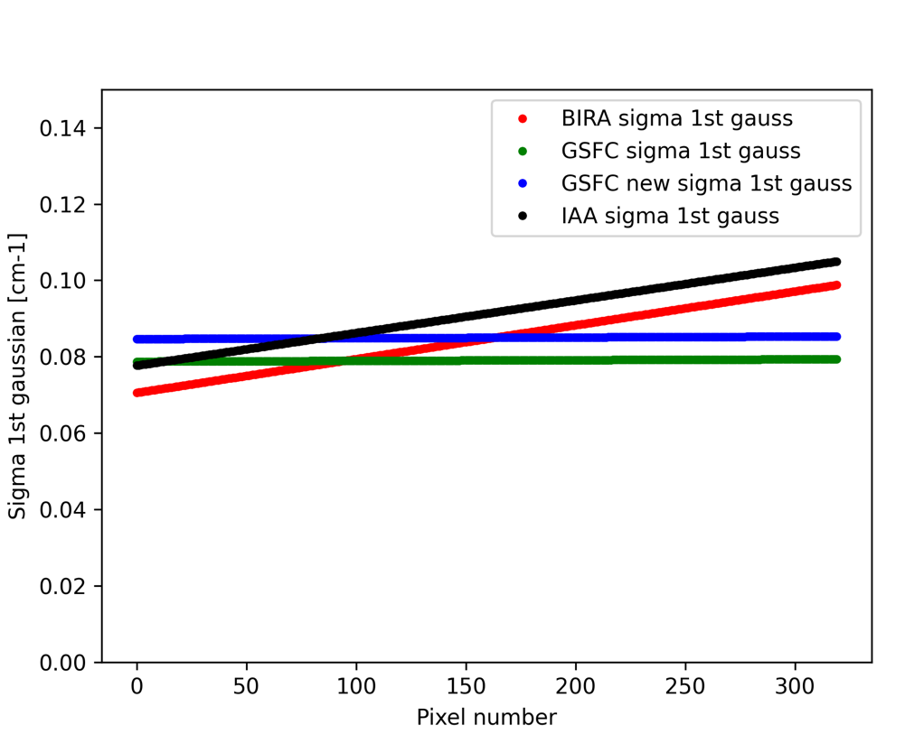
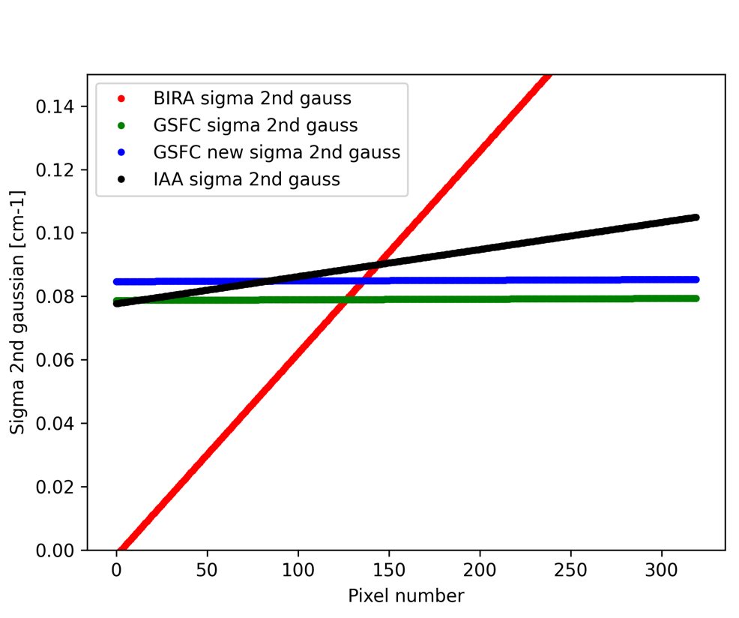
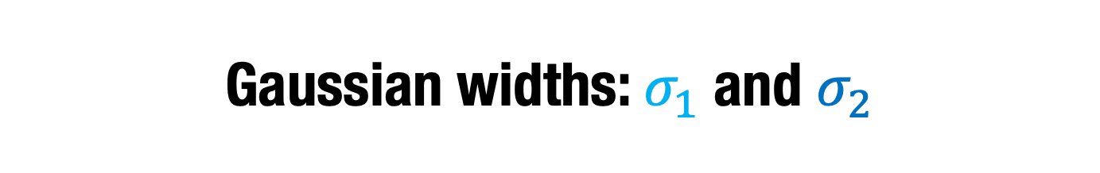
Gaussian widths: $σ_{1}$and $σ_{2}$

Slide 17
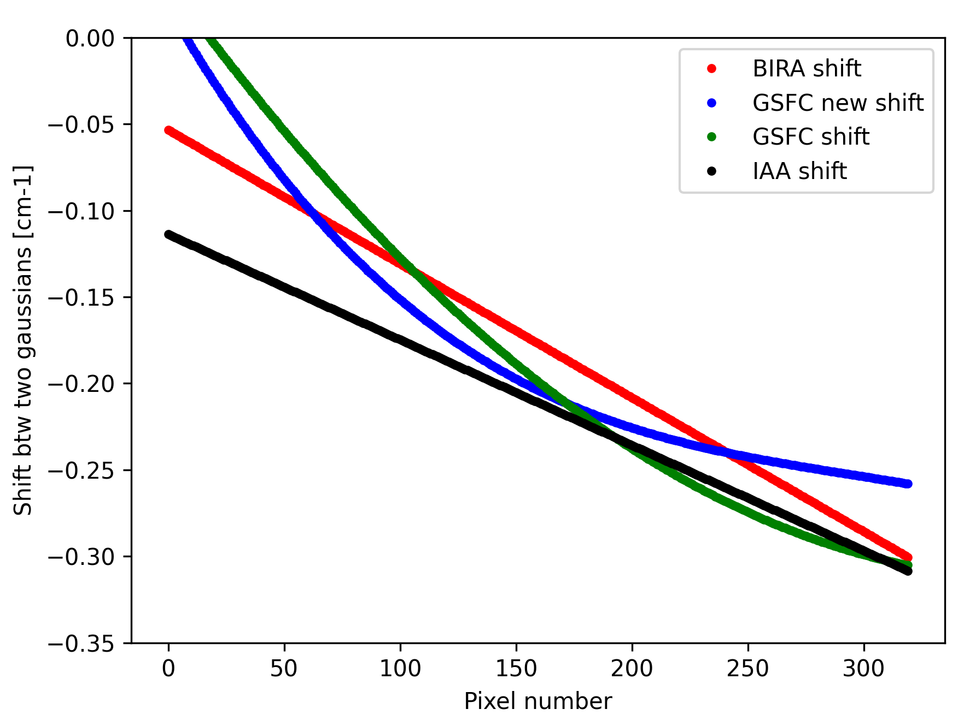
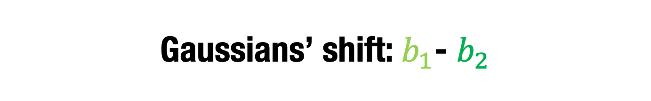
Gaussians’ shift:${ b}_{1}$- $b_{2}$

Slide 18
2-D images of the solutions

Slide 19
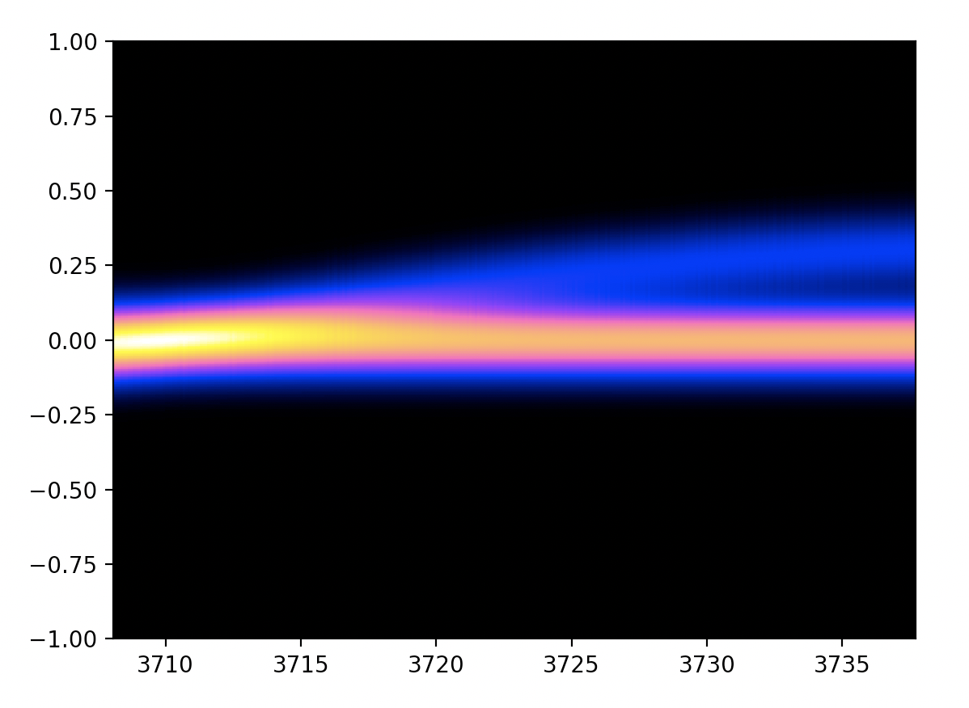
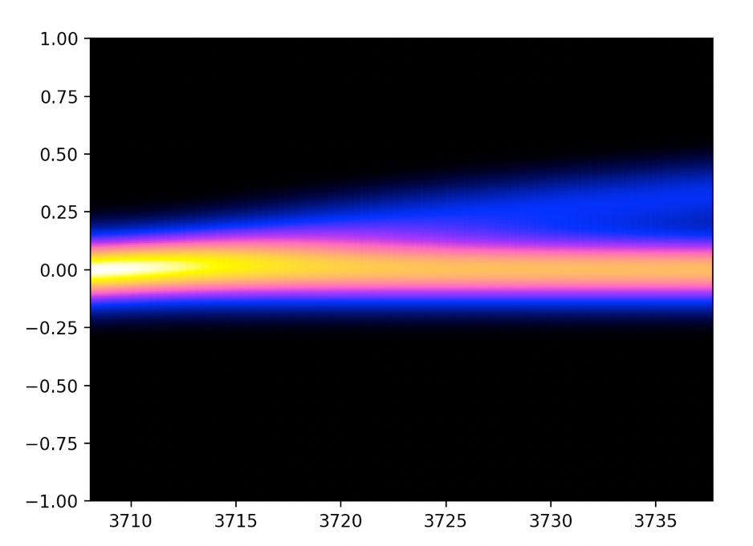
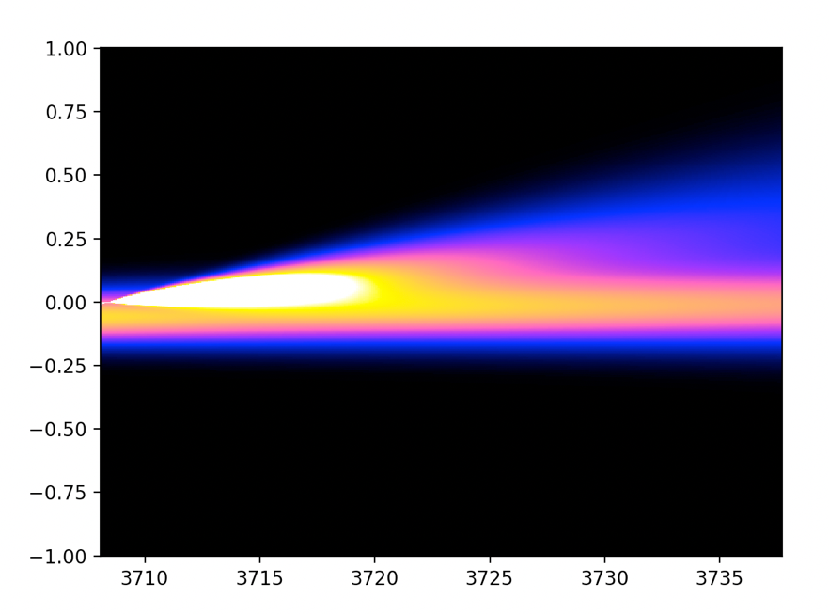
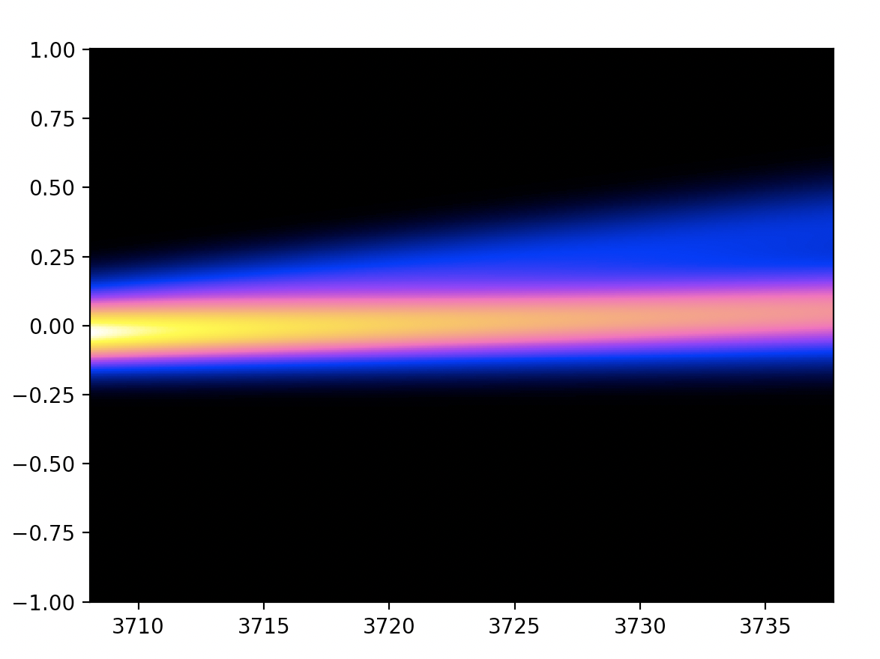
GSFC old
GSFC new
BIRA
IAA

Slide 20
Comparison between fits using different solutions

Slide 21
Order 165: spectra between 65 and 160 km fit
To test the different solutions, we have created a Python code that collects them into a module, which is then used to convolve high-res radiances generated by PSG. The Python code also uses the AOTF solution as provided by Geronimo in the new update.
The code fits spectra from order 165, bin 3 from a full scan with all the ILS solutions and compares both retrieved CO₂ scaler (w.r.t. GEM) and the chi-square.
This is a way to directly compare the quality of the solutions with the data, and to iterate to further refine the ILS parameterization. It is also a way to understand how many parameters we effectively need to produce a meaningful ILS solution.

Slide 22
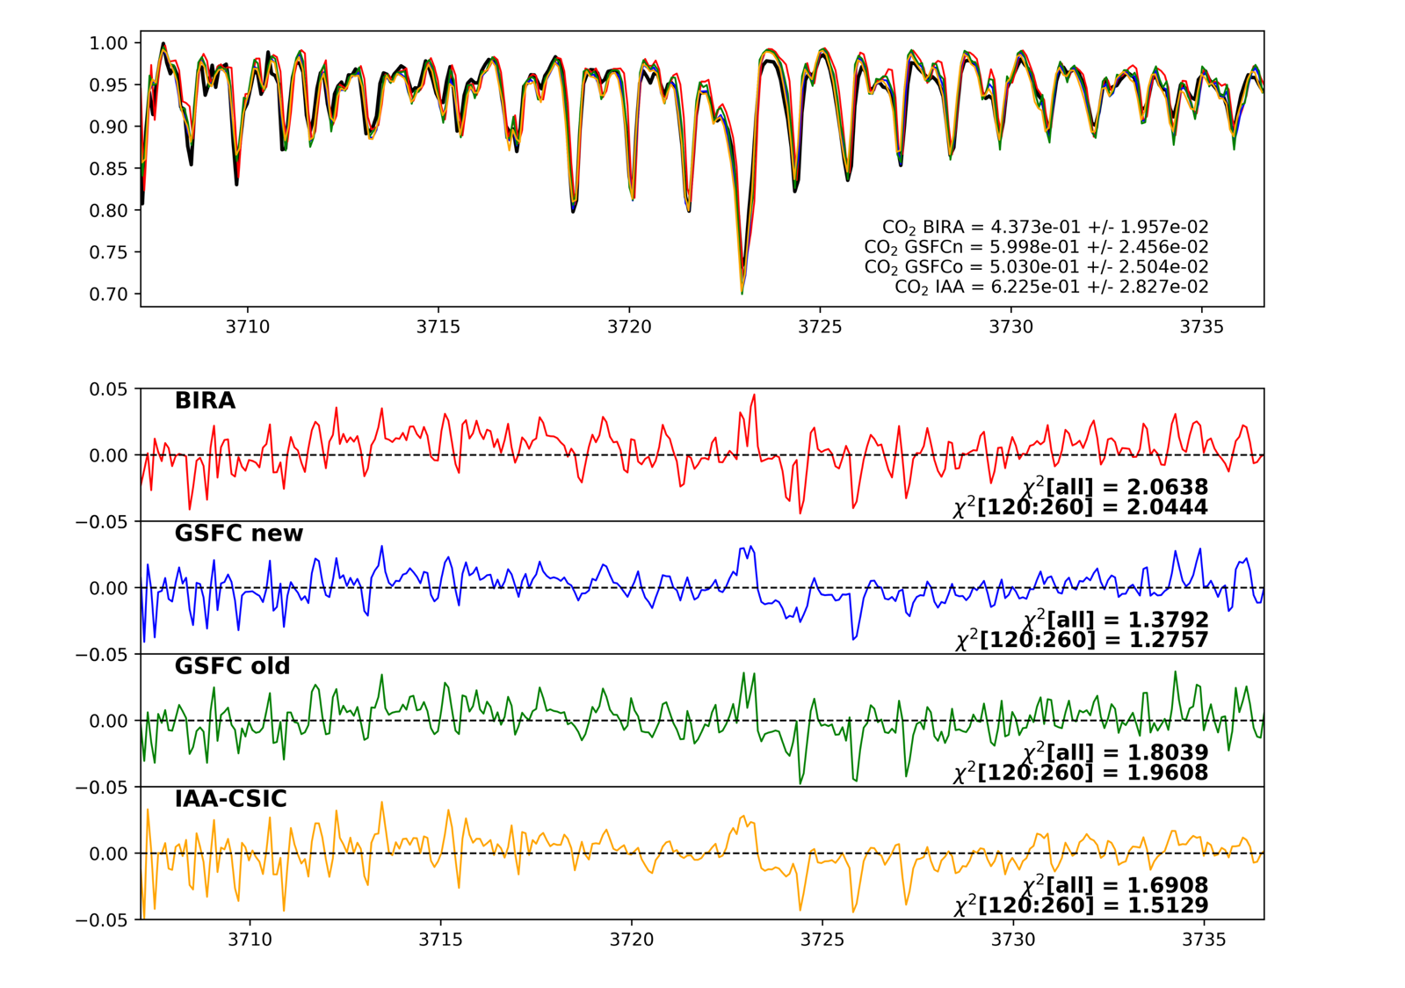
H = 67 km

Slide 23
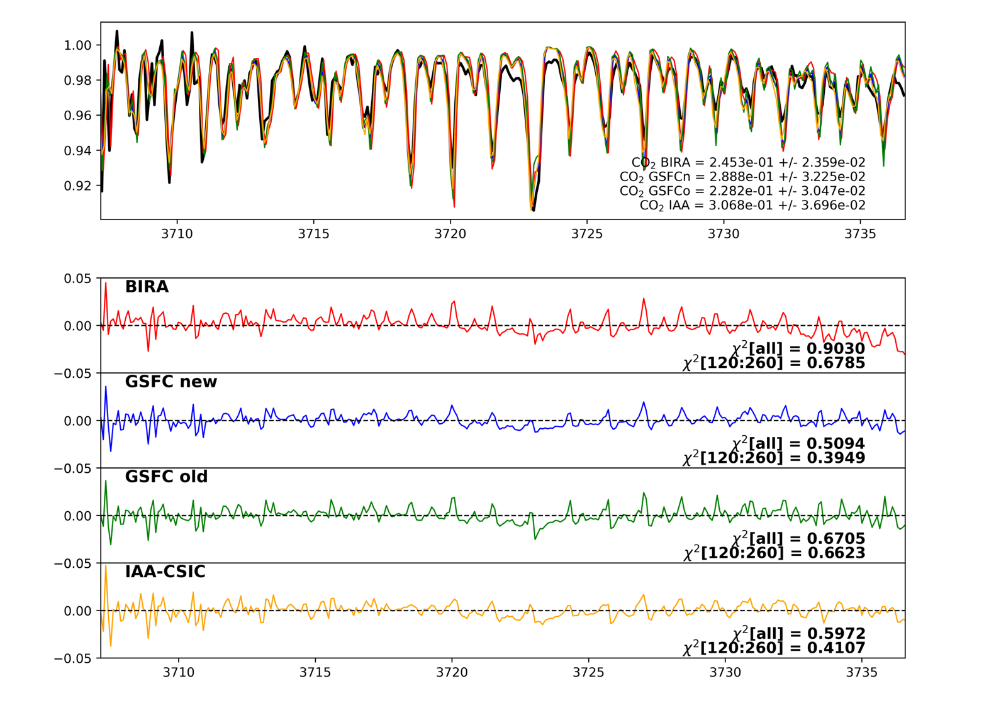
H = 85 km

Slide 24
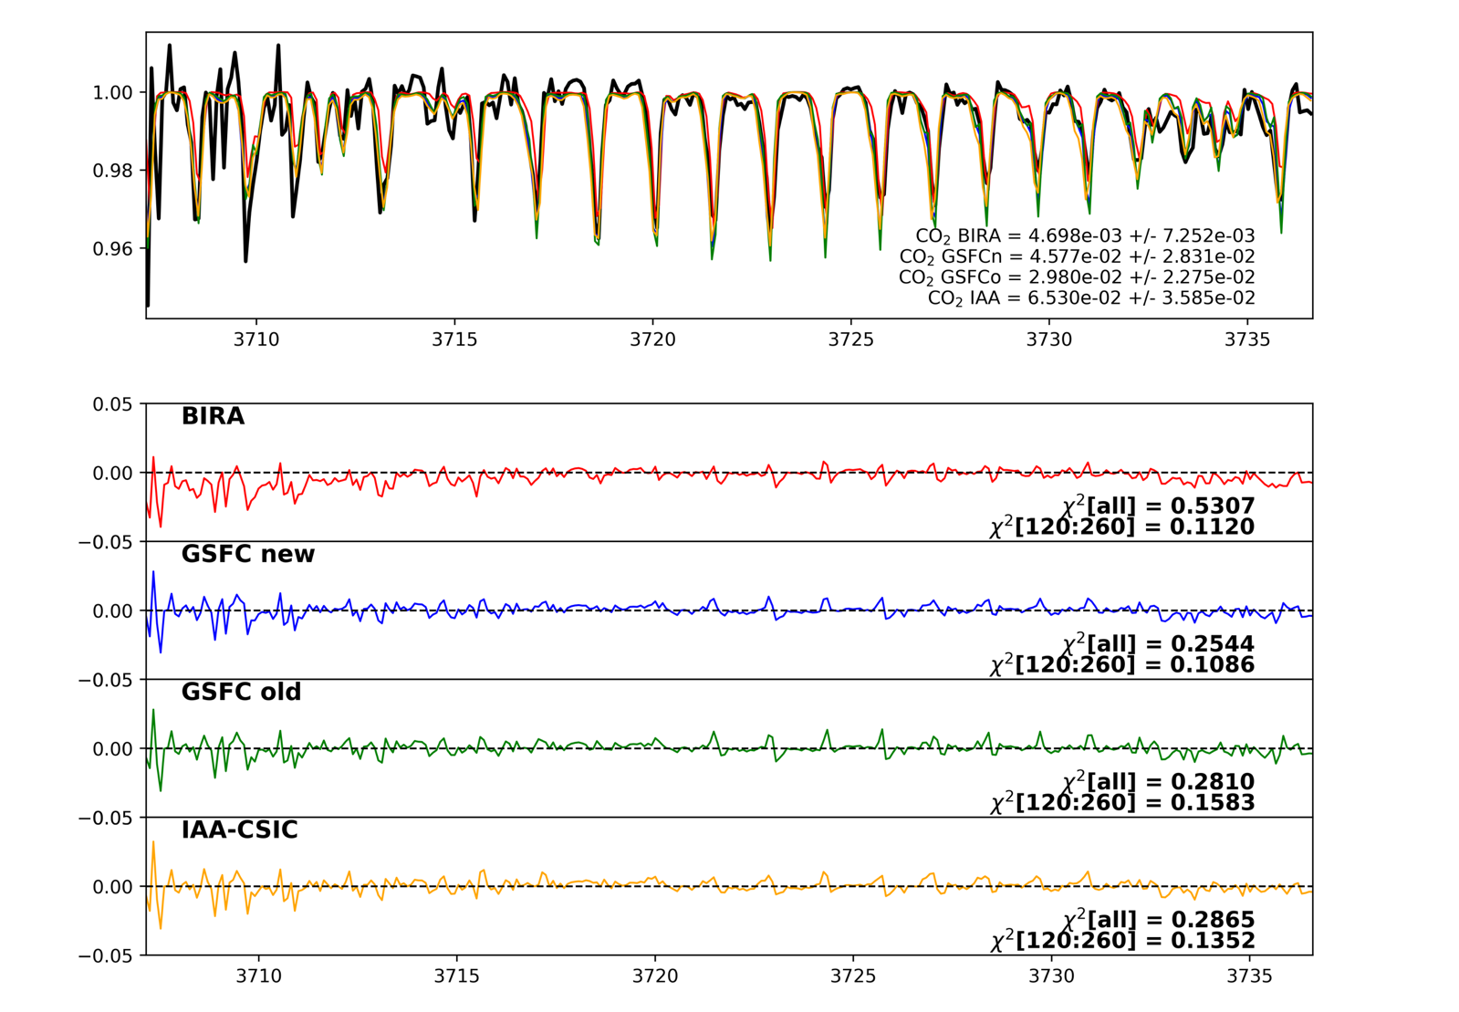
H = 103 km

Slide 25
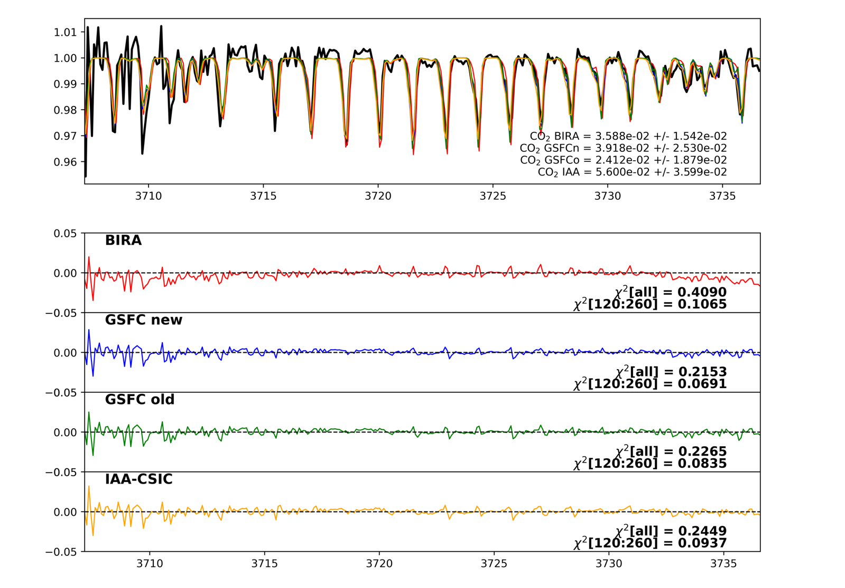
H = 113 km

Slide 26
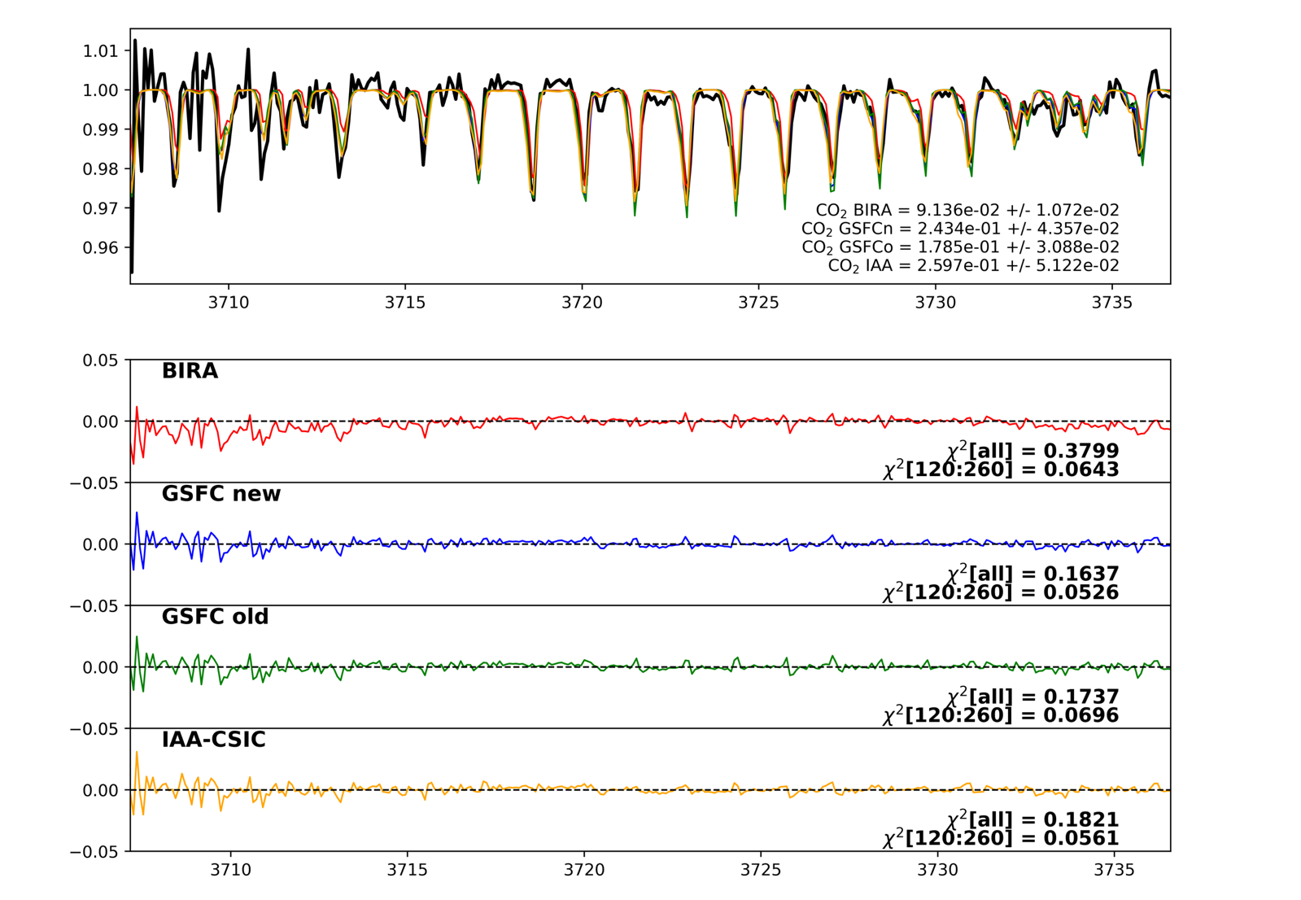
H = 131 km

Slide 27
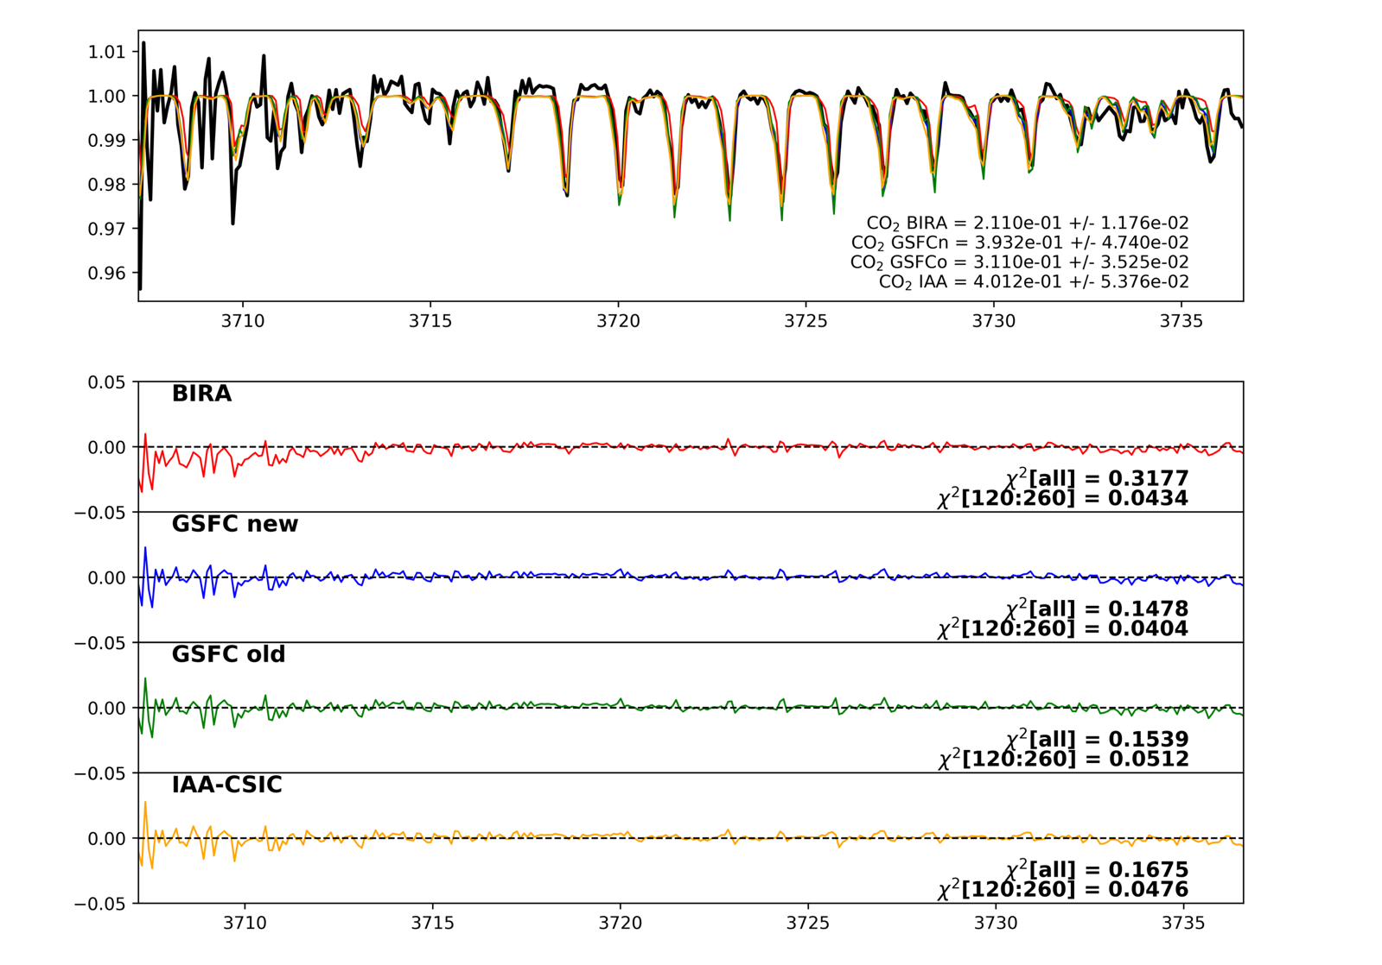
H = 141 km

Slide 28
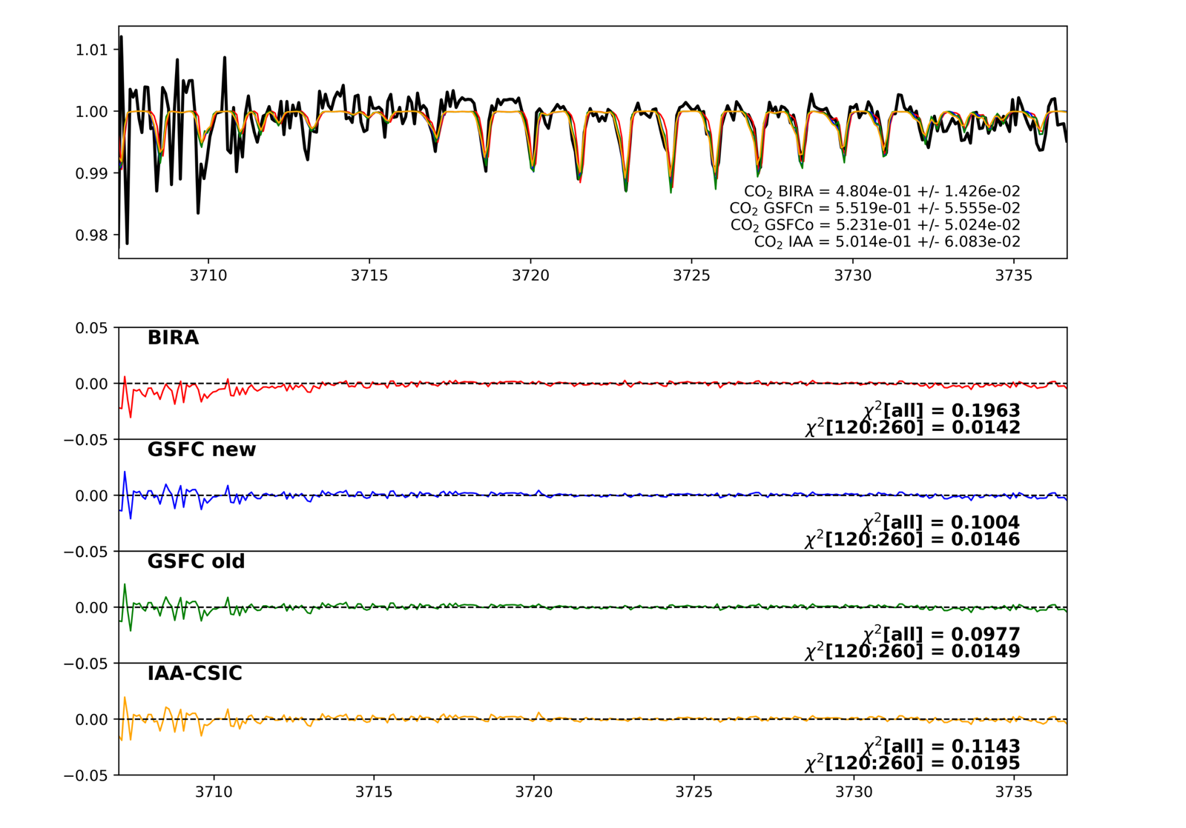
H = 160 km

Slide 29
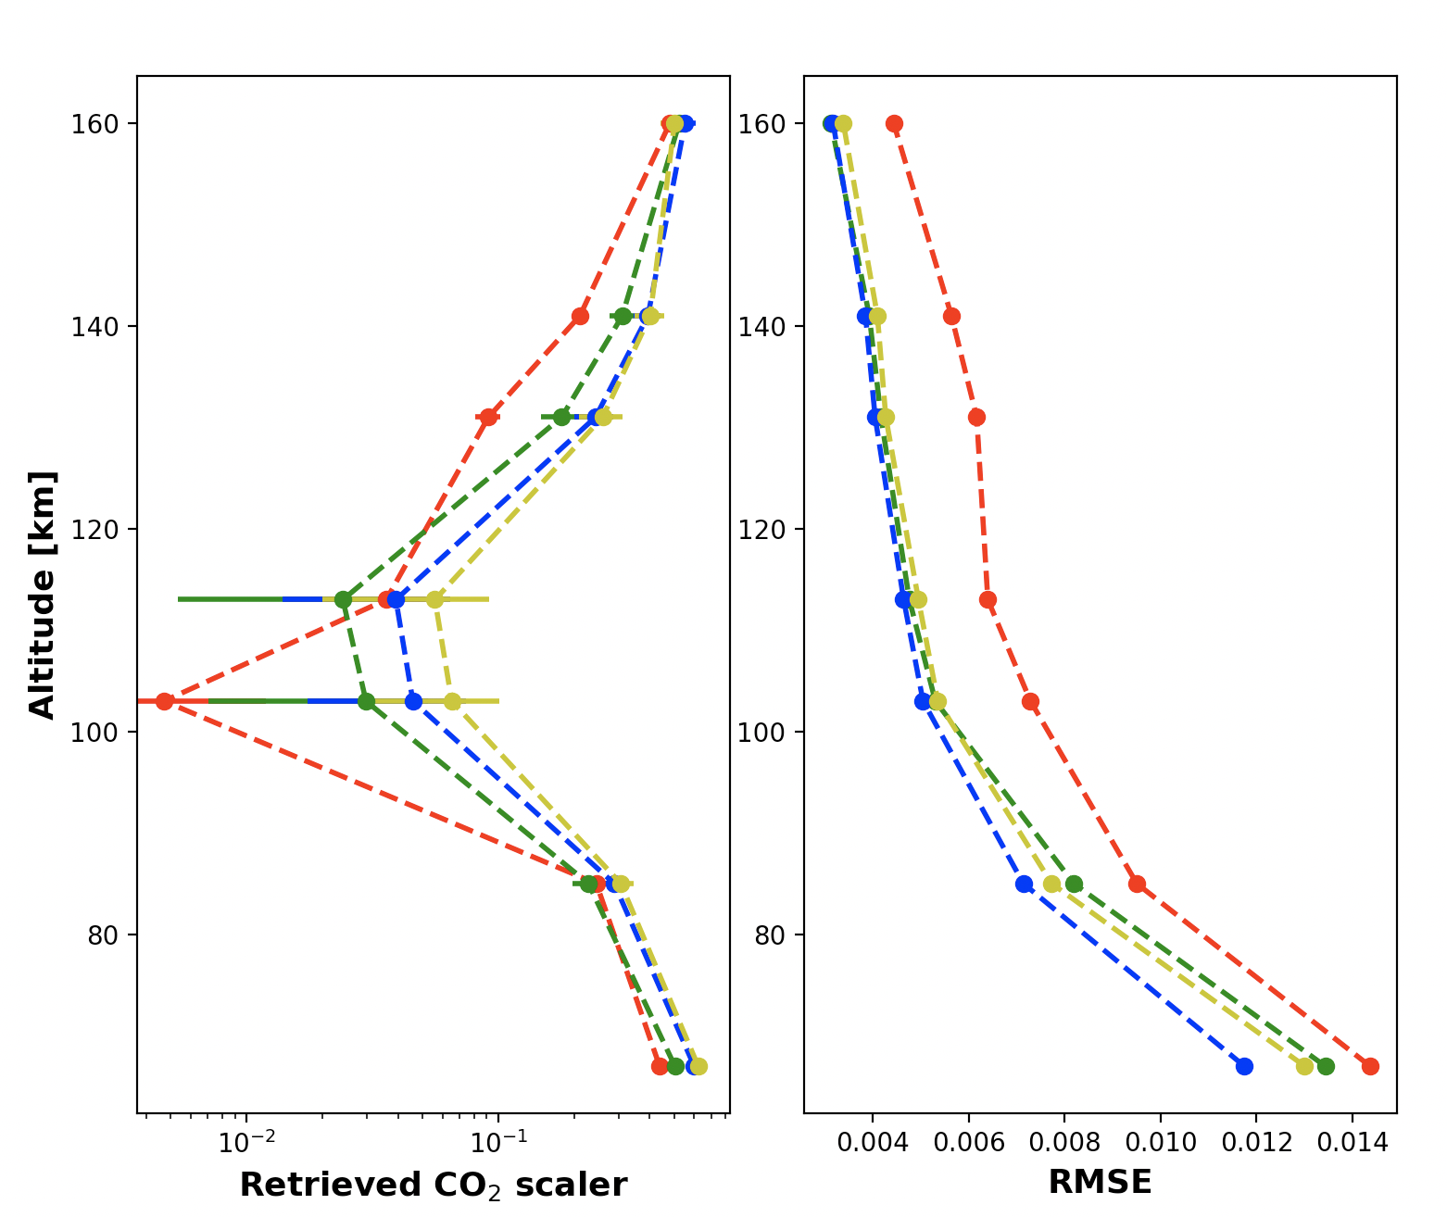
BIRA
IAA
GSFC-old
GSFC-new
BIRA
IAA
GSFC-old
GSFC-new
All the solutions look consistent, with differences only in the CO₂ scaler around 100 km (lines start to
“de-saturate” and ILS is critical)

Slide 30
Overall recipe

Slide 31
Using the same methodology for all the orders, we have first derived for each of them the σ, A₂ and the polynomial shift of the two gaussians.
Then we fit the average polynomial shift and derive its final expression. The σ, A₂ are constant across the orders and calculated as the average of the values obtained by each order. We could not identify any specific trend of these parameters with diffraction order (more on that in a few slides).

Slide 32
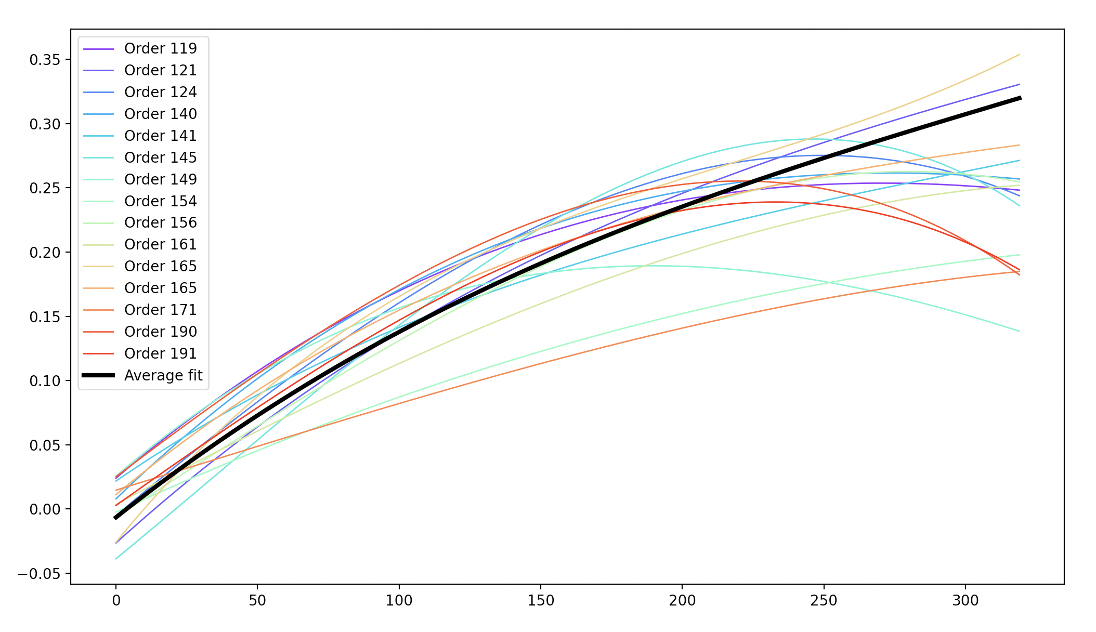

Gaussians’ shift:${ b}_{1}$- $b_{2}$ for several orders
Wavenumber x 3700/v_{cent}
Pixel number

Slide 33

Is there σ and/or $A_{2}$ variability across orders and pixels?
Cross-correlation is not able to provide solid constraints on these two parameters, which are better constrained by searching for the best fit quality, varying them.
For each order, we do the fitting of data at non-saturated altitudes for several values of σ and A₂, which allows to see if there is any variability with order and pixel.
Amplitude A₂
Example: order 165, H=131 km
Resolving power (~ σ)

Slide 34
Example: order 165, H=131 km
Pixels 0 to 100
Pixels 240 to 320

Slide 35
Example: order 141, H=50 km
Pixels 0 to 100
Pixels 240 to 320

Slide 36
Example: order 122, H=35 km
Pixels 0 to 100
Pixels 240 to 320

Slide 37
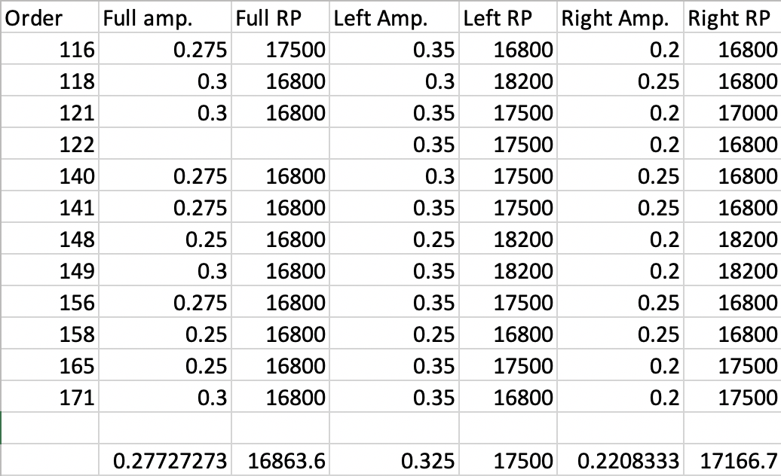

Slide 38
CO₂ profiles using different orders

Slide 39
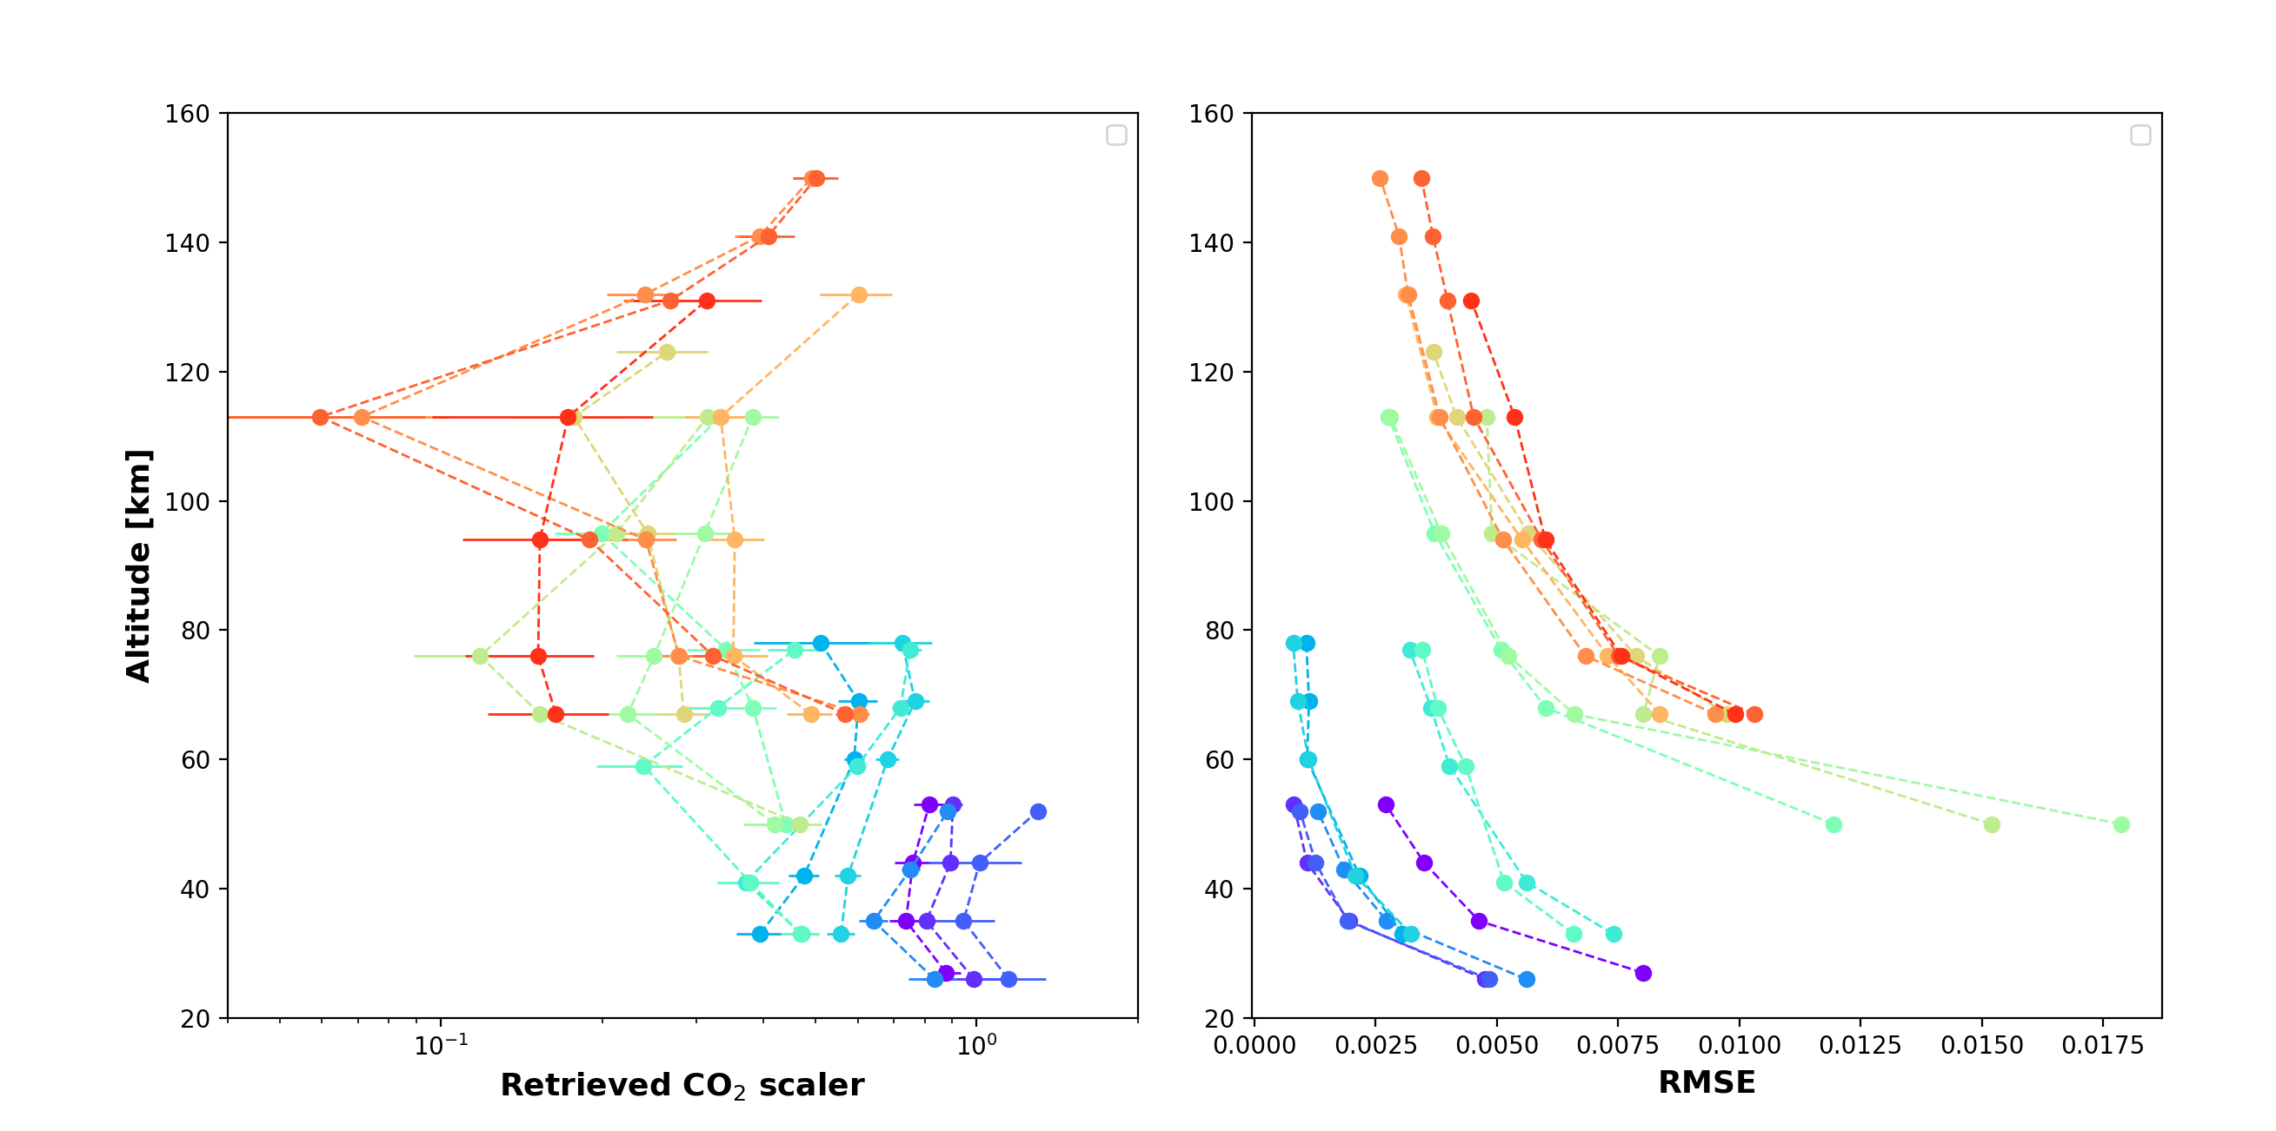
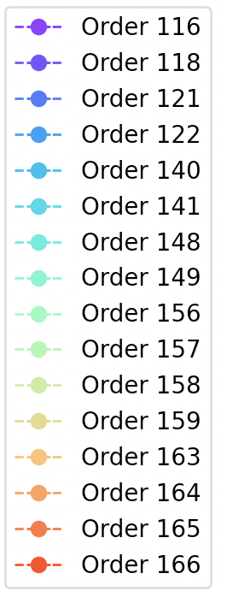
ILS GSFC new solution

Slide 40
Every profile is characterized by a different level of opacity. We thought about possible hypotheses to explain those and the sharp minima in the profiles at the altitude where lines start to become less saturated:
Bias in the dark correction
ILS issues
AOTF offset/gaussian continuum

Slide 41
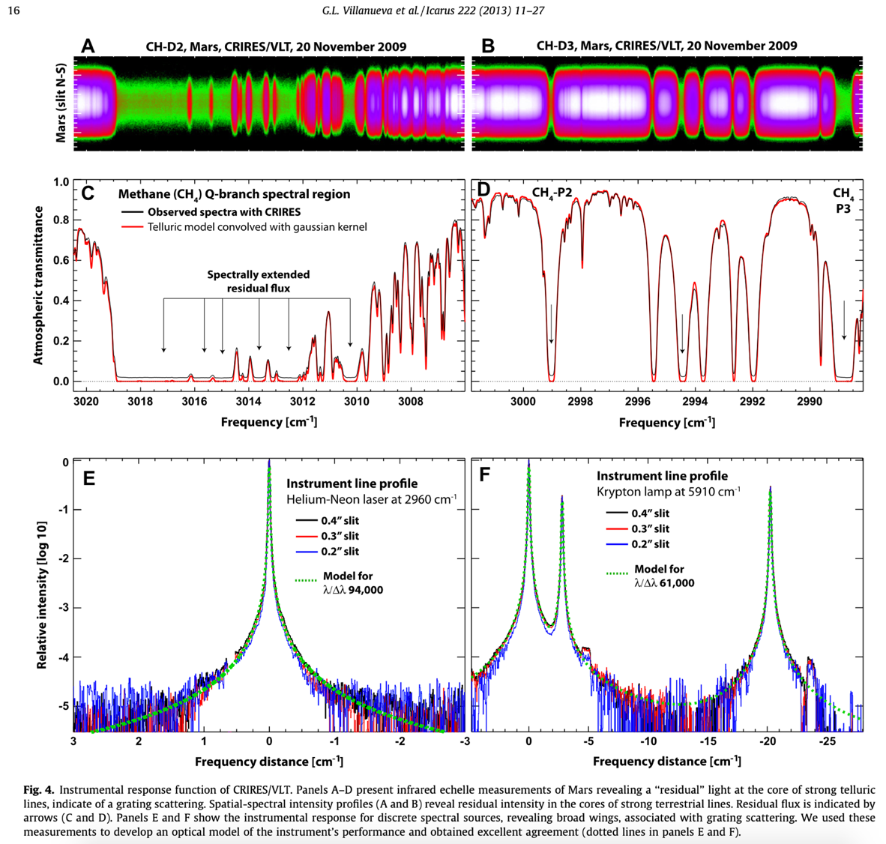

Slide 42
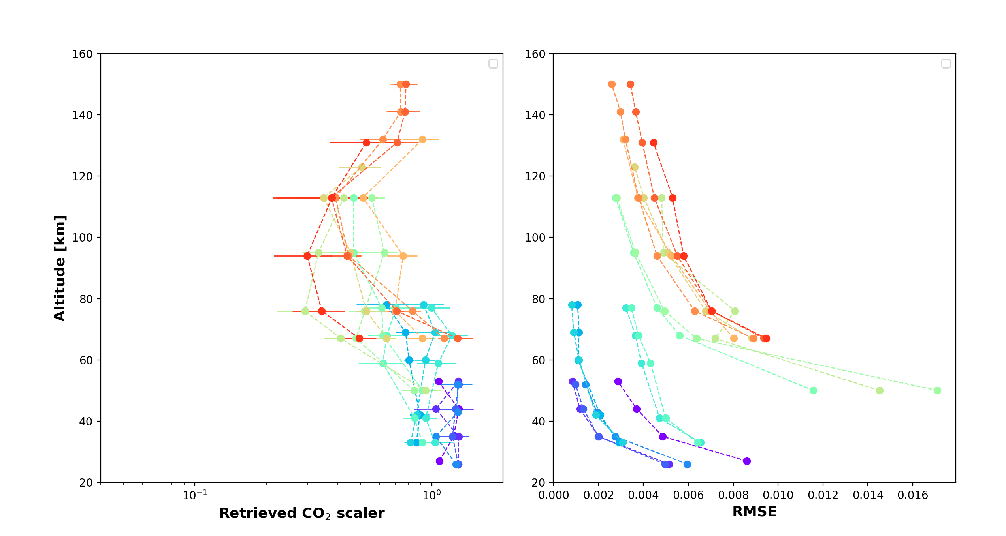
ILS GSFC new solution + 25% offset

